Slide 1
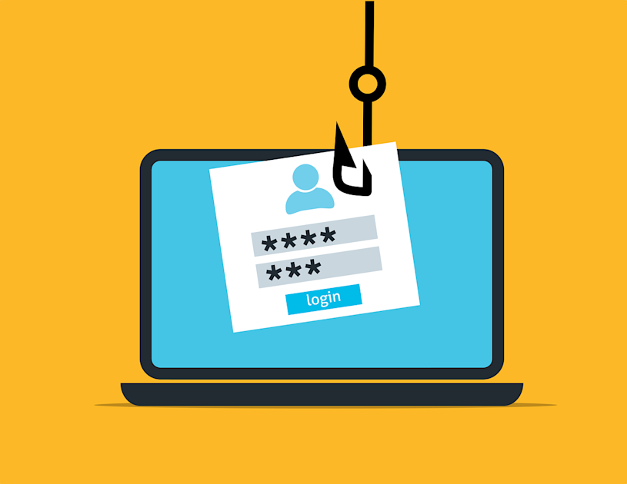
Jason Man
By: Jason Man
Measuring Mitigation Effectiveness: Click Rates and Report Rates

Slide 2
Measuring Mitigation Effectiveness
1
Click rate and report rate give complementary views of phishing-simulation performance
Two metrics together give the clearest picture of whether a phishing simulation program is improving.
CLICK RATE
↓
REPORT RATE
↑
Percentage of employees who clicked the simulated phishing link.
A downward trend indicates improving judgment.
Percentage of employees who correctly reported the simulation instead of clicking.
An upward trend indicates stronger vigilance.
Key Takeaway:
A stronger program should generally produce fewer clicks and more correct reports over time.

Slide 3
Click Rate
2
How often employees click the simulated phishing link
CLICK RATE
WHAT IT MEASURES
HOW TO READ IT
↓
Employees who clicked
If the rate falls across repeated simulations, employees are becoming less likely to click.
divided by
Desired direction
Employees in the simulation
LOWER OVER TIME
Look for the trend—not just one simulation result.
Fewer employees are acting on the simulated lure.
This shows the percentage of participants who interacted with the phishing link.
Key Takeaway:
A downward click-rate trend indicates improving judgment during phishing simulations.

Slide 4
Report Rate
3
How often employees correctly report the phishing simulation
REPORT RATE
WHAT IT MEASURES
WHY IT MATTERS
↑
Employees who correctly reported
A rising rate suggests a strengthening culture of vigilance and reporting.
divided by
Desired direction
Employees in the simulation
HIGHER OVER TIME
This can be even more valuable than seeing click rate fall by itself.
More employees recognize and escalate the simulated phishing attempt.
This shows how often employees actively respond to the simulated threat.
Key Takeaway:
A higher report rate shows employees are not only avoiding the lure—they are taking the correct defensive action.

Slide 5
Why the Two Metrics Belong Together
4
Click rate measures risky action; report rate measures the desired defensive response
Looking at only one metric can miss part of the behavior the simulation is trying to improve.
LOW CLICKS + HIGH REPORTS
LOW CLICKS + LOW REPORTS
Best signal: employees avoid the lure and actively report it.
Employees may avoid clicking, but reporting behavior is still weak.
HIGH CLICKS + HIGH REPORTS
HIGH CLICKS + LOW REPORTS
Awareness exists, but too many employees still interact with the lure.
Weakest combination: risky interaction remains high and escalation remains low.
Key Takeaway:
The clearest improvement is movement toward lower click rates and higher report rates at the same time.

